Slide 1
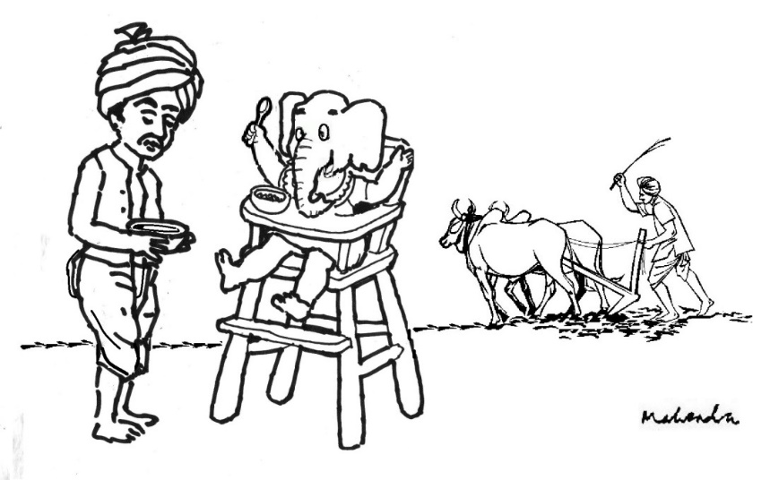
KisaanSaathi Enabling prosperity for farmers
Satish Vivek Kesava Rao Roshni Dinesh Aruna Upendra Atul Jyotsna

Slide 2
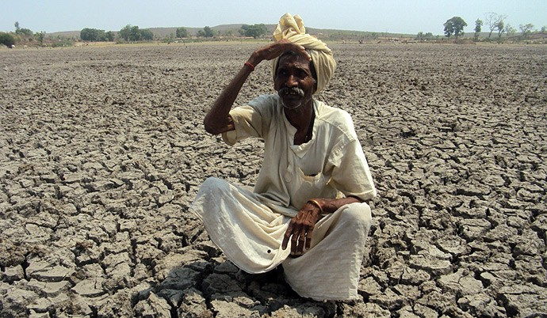
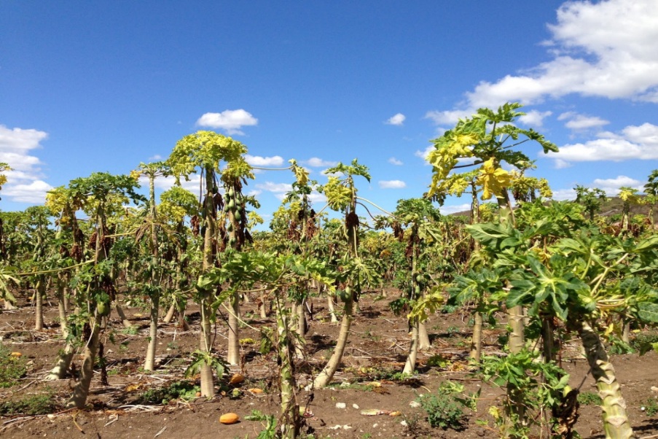
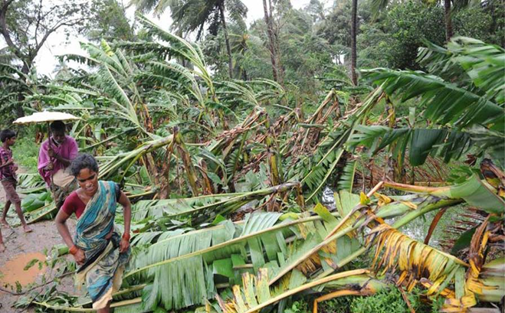

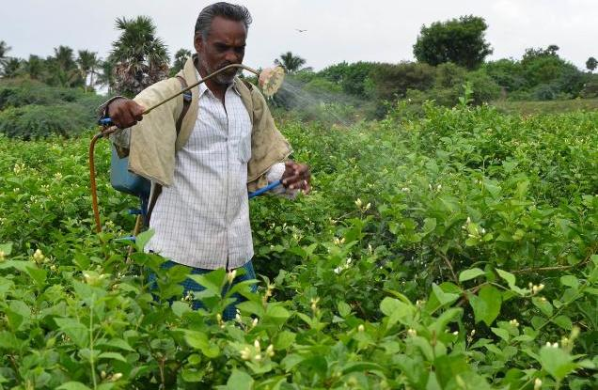

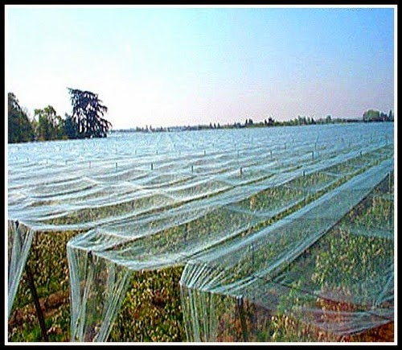

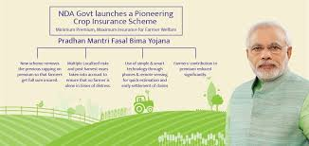

What ails the Indian Farmer?
Notes:
Everyone here probably agrees that farming is not the easiest occupation to do –anywhere in the world ..and especially in India. Changing weather patters, disease, lack of water or power , problems selling at the right price all make it really difficult especially for an uneducated small farmer. What does this mean? Does it mean India’s farmers should all give up farming? Is there really nothing to help them? Maybe causing rainfall is something we can’t do but there are a lot of small things we can do that can make a difference to farmers – there are ways in which diseases can be managed and prevented, there are schemes and subsidies that govt runs to help farmers –how can we bring these elements closer to the small indian farmer –that is the theme of our app today!

Slide 3
What are the farmers’ needs?
Personalized
Timely
Insightful
Information customized for ME
My crop
My farm
My location
My language
My applicable benefits
Weekly expected stages of crop help me track healthy growth
Weather alerts with customized info for MY crop
Detect intervention needed for specific events
Prediction on impending diseases on pests so I can protect against it
Historical data to predict expected risk and projected yield based on current conditions
Increased yield &
income
?

Slide 4


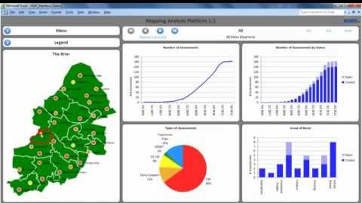







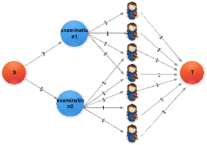


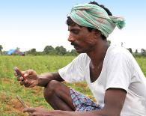






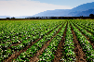










Data driven platform to provide personalized and timely insights
REAL TIME MONITORING
(Agri Dept, Policy Makers, Researchers)
SOIL HEALTH
WEATHER
SCHEMES & INFO
KISAN
SAATHI
IMAGE RECOGNITION
ANALYTICS
CONTEXTUALIZED REAL-TIME SCHEDULER
CONTEXTUALIZED REAL-TIME ADVISORY
SOWING
IRRIGATION
FERTILIZER
HARVEST
CROP LIFE CYCLE
PEST
WEATHER
SUBSIDY

Slide 5



KisanSaathi – Poverty to Prosperity (P2P)

Slide 6
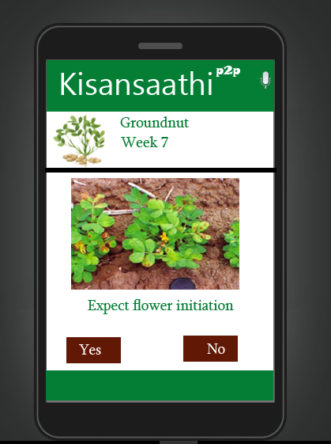

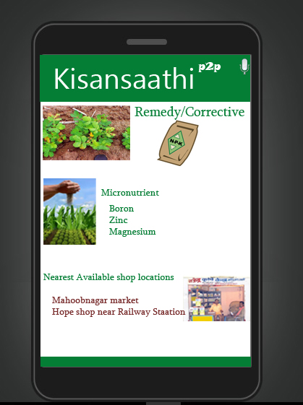
KisanSaathi – Poverty to Prosperity (P2P)

Slide 7
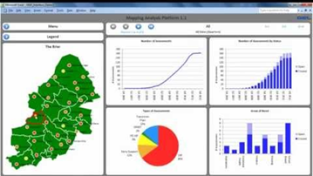
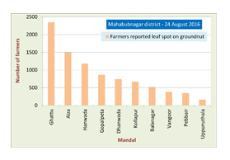
KisanSaathi – Poverty to Prosperity (P2P)
Near real time reports on both biotic and abiotic stresses on crops
Government
Farm Input Providers

Slide 8
Business model & partnerships
Monetization
Nominal subscription fee
Ad revenue
Fee from businesses – Pesticides, farm implements
Partnerships
Government agencies
Fertilizer companies and pesticide companies
Banks

Slide 9
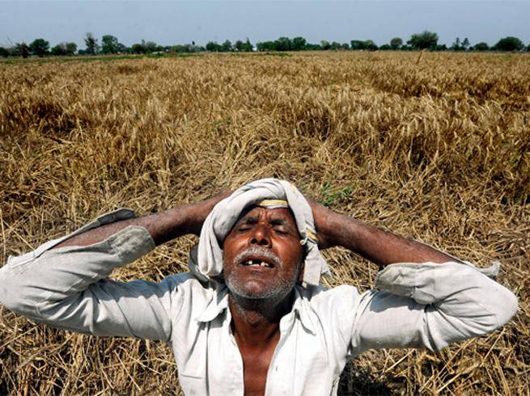
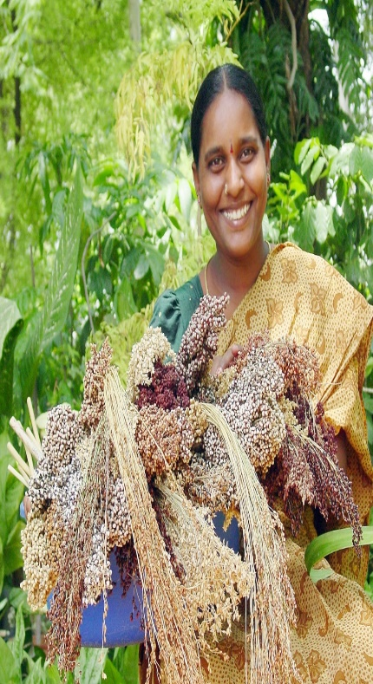

Tell me what to grow
Help me grow
Help me sell
Thank you

Slide 10













Sources of data

